Slide 2
A * ALGORITHM

Slide 3
Agenda
What Is A Star Algorithm and how it works ?
Why we choosed This Algorithm ?
How can we implement A * Algorithm?
Recap
./ Powepoin.exit()

Slide 4
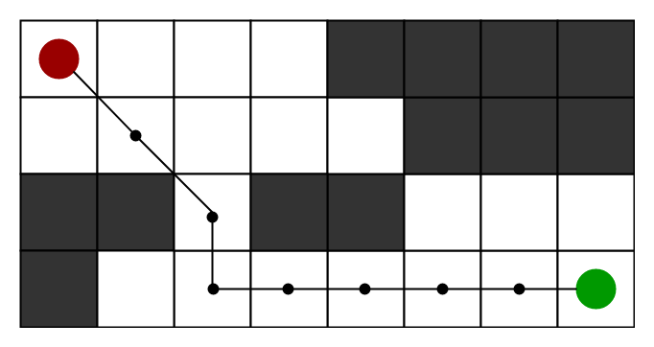
What Is A Star Algorithm and how it works ?
A * algorithm is a searching algorithm that searches for the shortest path between the initial and the final state

Slide 5
EXAMPLE
F
B
3
A
D
3
2
4
3
C
3
E
A => C => E =>F

Slide 6
VertiCES | A(g) | h | F=g+h
A | 0 | 10 | 10
B | 3,3 | 8 | 11,11
C | 3 | 7 | 10
D | 5 | 5 | 10
E | 6 | 2 | 8
F | 4 | 0 | 4

Slide 7

Why we choosed This Algorithm ?

Slide 8
Informally speaking, A* Search algorithms, unlike other traversal techniques, it has “brains”. What it means is that it is really a smart algorithm which separates it from the other conventional algorithms

Slide 9
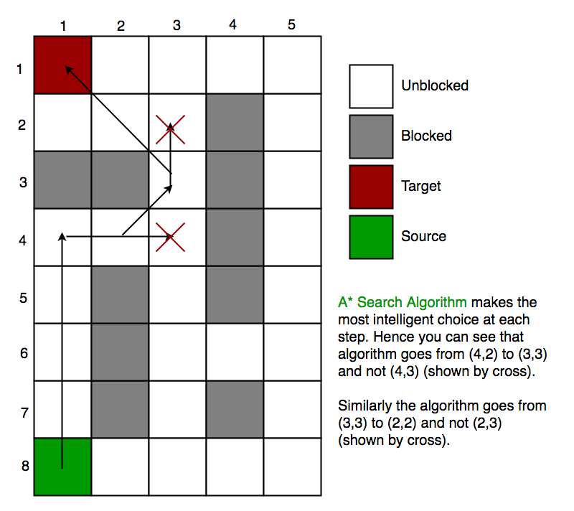


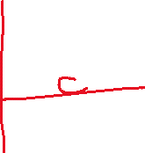

Slide 10
How can we implement A * Algorithm?

Slide 11
Initialize the open list
Initialize the closed list put the starting node on the open list (you can leave its f at zero)
while the open list is not empty
a) find the node with the least f on the open list, call it "q"
b) pop q off the open list
c) generate q's 8 successors and set their parents to q
d) for each successor
i) if successor is the goal, stop search successor.g = q.g + distance between successor and q successor.h = distance from goal to successor (This can be done using many ways
ii) if a node with the same position as successor is in the OPEN list which has a lower f than successor, skip this successor
iii) if a node with the same position as successor is in the CLOSED list which has a lower f than successor, skip this successor otherwise, add the node to the open list end (for loop) e) push q on the closed list end (while loop)

Slide 12


RECAP

Slide 13
Catch The code
Styling part
Variables part
Initializing part
Algorithm part
Pygame contents part
Driver Code Part

